Slide 1


KINDERGARTEN WEB APP
Timothy Nuwarinda
Yvon Remy Hagenimana
Anteneh Tessema

Slide 2
Introduction
This is a web application that enables kids (in Kindergarten School) learn the fundamental principals learned in their first experience with formal education

Slide 3
Scope
This project is limited to generating quizzes for children for them to learn and practice the basic skills of learning the alphabet, counting numbers and coloring shapes
The application does not keep track of their history and thus is just a platform for practice.
Also, we make an assumption that the kids are to young to maneuver their way around the application, and so we advise parental guidance.

Slide 4

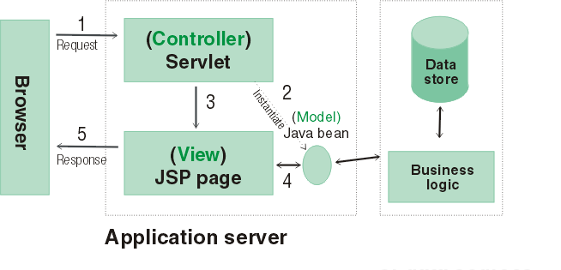



System Architecture

Slide 5



Technologies Used
Languages and libraries– Java, Javascript, jquery HTML5, css3
Frame works – Bootstrap
Project Management- Github, trello

Slide 6
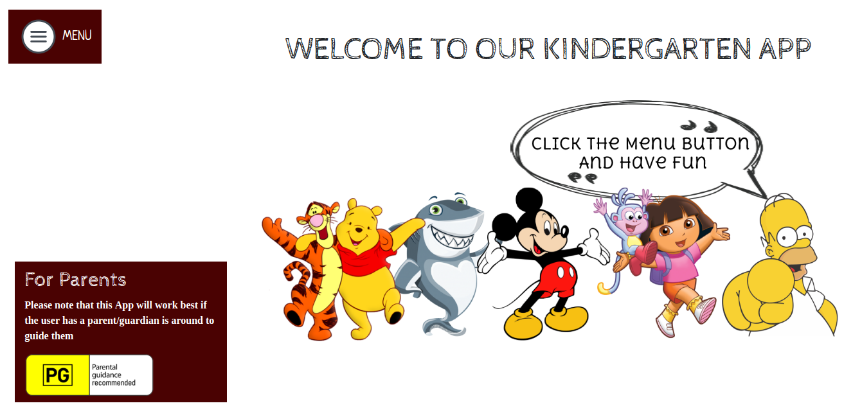
HOME PAGE

Slide 7
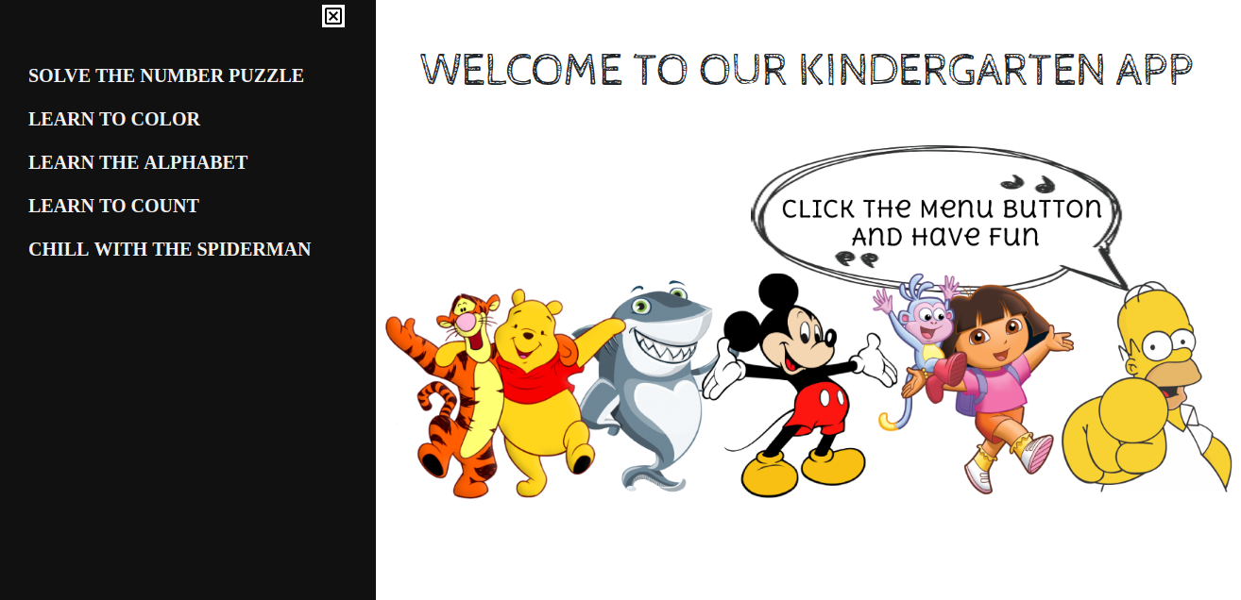
MENU

Slide 8
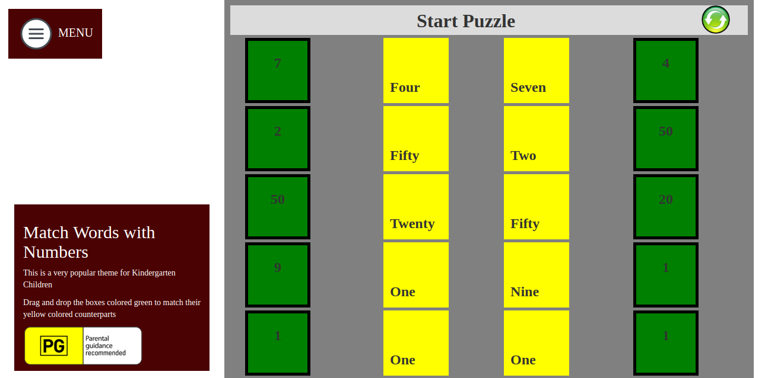
NUMBERS PUZZLE

Slide 9
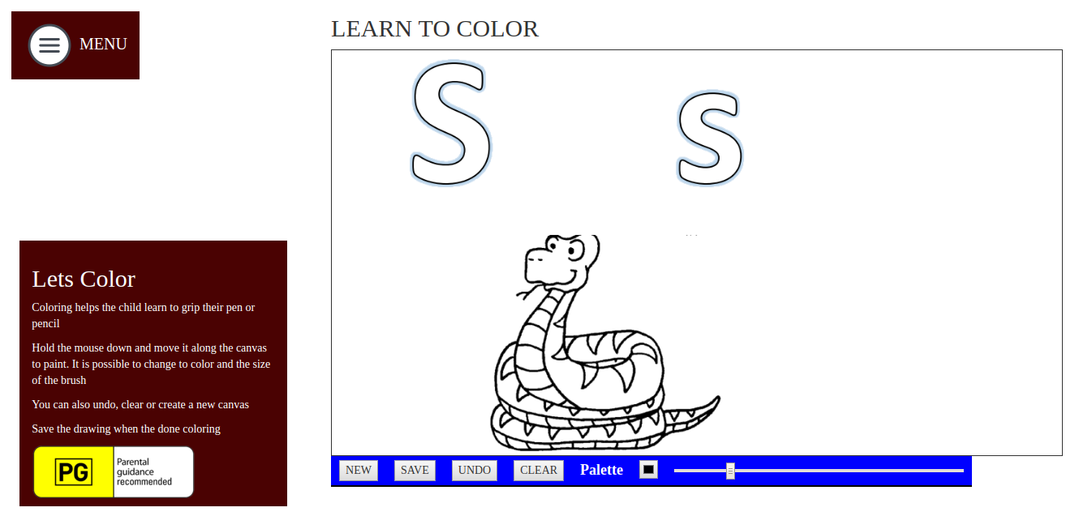
COLORING MODULE

Slide 10
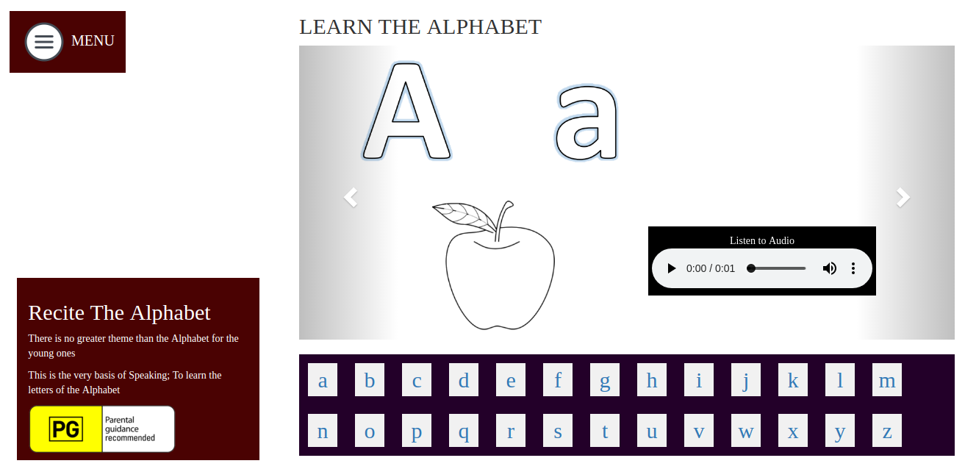
LEARNING THE ALPHABET

Slide 11
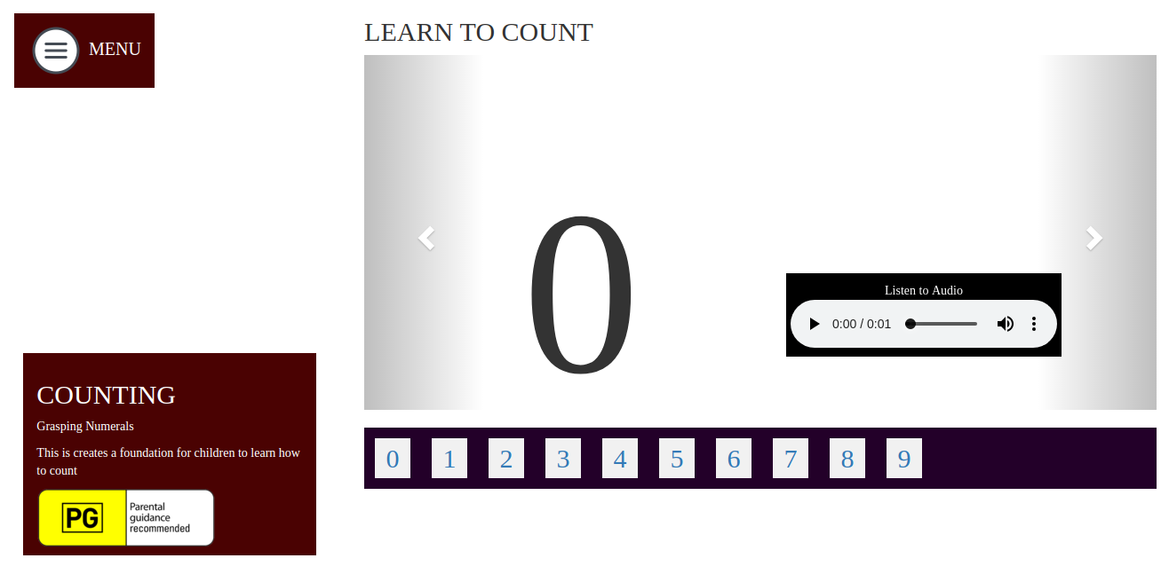
LEARNING TO COUNT

Slide 12

A LITTLE GAME OF STARS

Slide 13
FUTURE FEATURES
As a means to advance on this application, there is need to add an account module as a means to track the history of the child and make a report on their progress.
That way, parents can log back in and check their kids’ work

Slide 14
Thank You

